Slide 1

Lesson 5.01: Earsketch Intro
Microsoft Philanthropies TEALS Program
Introduction to Computer Science
Semester 2

Slide 2
Earsketch Intro
After this lesson, you will be able to...
Define and identify Digital Audio Workstation (DAW), sound tab, fitMedia(), setTempo()
Demonstrate beats using the above functions
Demonstrate Looping through items in a list

Slide 3
Today’s Plan
Day 1
Do Now
Lesson
Lab
Debrief
Notes:
10 Minutes Do Now
10 Minutes Lesson
30 Minutes Lab
5 Minutes Debrief

Slide 4
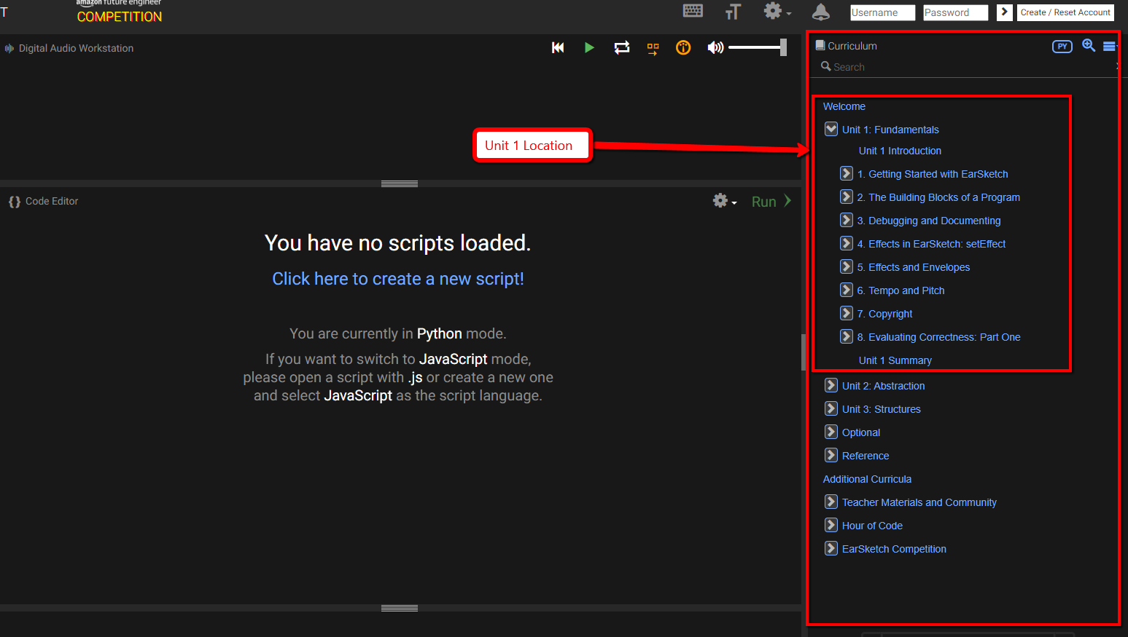
Earsketch Curriculum Location
Direct Link - https://earsketch.gatech.edu/earsketch2/#?curriculum=1-0

Slide 5
Do Now – Earsketch Exploration
Read through and participate in the following lessons in Earsketch
1.1.2 Tools of the Trade: DAWs and APIs
1.1.3 The EarSketch Workspace
1.1.5 The DAW in Details
1.1.8 Creating a New Script
1.1.9 Composing in EarSketch - fitMedia()
In your notebook, write down any terms or phrases stand out to you as you work though these lessons.

Slide 6
Activity
# python code
# script_name: Intro_Script
# author: The EarSketch Team
# description: This code adds one audio clip to the DAW
#Setup Section
from earsketch import *
init()
setTempo(120)
#Music Section
fitMedia(TECHNO_SYNTHPLUCK_001, 1, 1, 9)
#Finish Section
finish()
Enter the code to the right into your console.
In your Notebook, What inputs does fitMedia() take?
Press the run button and describe what happened.

Slide 7
Lesson - Vocabulary
Digital Audio Workstation (DAW) is a piece of computer software for recording, editing, and playing digital audio files.
Audio files store information that the computer uses to play back music.
These audio files are called clips.
The DAW allows you to edit and combine multiple clips on a musical timeline
Two popular DAWs used in the music industry are Pro Tools and Logic Pro.
Notes:
If they say they would write down a lot of code, ask how readable that might be, or how long would it take to write, or the greater potential for bugs due to typos.
Go over part 2 of the Do Now. Ask the students what happened. Ask if they remember something similar from Snap!
Introduce the for loop as a way to deal with issues associated with part 1 of the Do Now.

Slide 8
Sound Browser
Tabs
Sounds: Here, you can browse and search a collection of short pre-made audio clips for you to use in your music.
Scripts: A list of your saved EarSketch projects.
Each script is a separate music project.
Click a project title to open it in a new tab (in the code editor panel).
API: A description of every EarSketch function.

Slide 9
Code Editor
A text editor with numbered lines. Type your code here, press "Run"
setTempo(): comes with a default argument of 120, but let's change it to 100. This sets the tempo of our project to 100 beats per minute. As you can see, the name of a function tells you what it does.
fitMedia(): to add sound to the DAW.
requires four arguments:
clip name
track number
starting measure
ending measure
For now, just type in fitMedia() without any arguments.

Slide 10
Lab - Earsketch
Create a basic EarSketch project using the following requirements:
Open the Earsketch DAW and log in.
Click “Options – Save Script to Cloud” and set a name for your song.
In comments at the top of your code, include your name, the name of the song (e.g. “Lab 5.01”), and a brief, clear description of the project.
Set the tempo of the project to 140 BPM.
Make 4 different variables that will hold the following constants:
DUBSTEP_BASS_WOBBLE_007
DUBSTEP_PAD_003
DUBSTEP_DRUMLOOP_MAIN_005
DUBSTEP_LEAD_004
Make at least 4 tracks using the fitMedia() function. Each track should be unique
Each of the tracks should start or stop on different measures (e.g. track 1 starts on measure 1, track 2 starts on measure 4, and so on).
Define and use at least 4 variables using 4 different constants from the EarSketch Audio Loop Browser.
The project should have a total length of 12 measures.
Include descriptive comments throughout your script.
Copy and save the script to your online IDE for turn in.

Slide 11
Debrief
Discuss
Were there any phrases or terms that you are still questioning?
Next
Read the rest of the lessons we didn’t go over in Earsketch.

